Slide 1
Agenda for GEOG260/360 GIS & Land Change Models
October 11
See CUGA announcement
Feedback on assignment 4
Discuss Assignment 5 and machine learning algorithms
Get instructions for Assignment 6
Skim Strzempko and Pontius - 2023 - The Flow Matrix Offers a Straightforward Alternati.pdf
October 12
Tanner office hours in the Academic Commons 11am-1pm
October 13
Submit Assignment 5 by 4pm on Canvas
October 16
Discuss Assignment 6
October 18
Submit Assignment 6 by 4pm on Canvas
Get instructions for Assignment 7

Slide 2

C.U.G.A. (Clark Undergraduate Geography Association)
What is CUGA?
Get involved!
Founded in 2000, now expanded to include Global Environmental Studies and Earth System Science
Open to all students, regardless of major or year
What student events would you like to see?
Each Chief Associate (CA) spearheads events, trips, or a project of their own design
Vote for the events you would like to see to elect the CUGA leaders
What is it used for?
Offers informal academic support and advice regarding program requirements, internship and career search, opportunities for research, or other general questions related to our nationally acclaimed department
Wednesdays 5:30-7:30pm, or email cuga@clarku.edu
Building community between geography students of all years and concentrations
Email with poll coming soon, Vote by Wednesday, October 18th

Slide 4
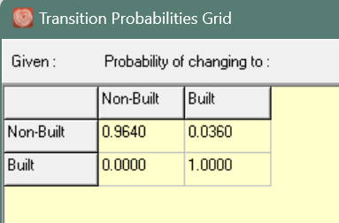
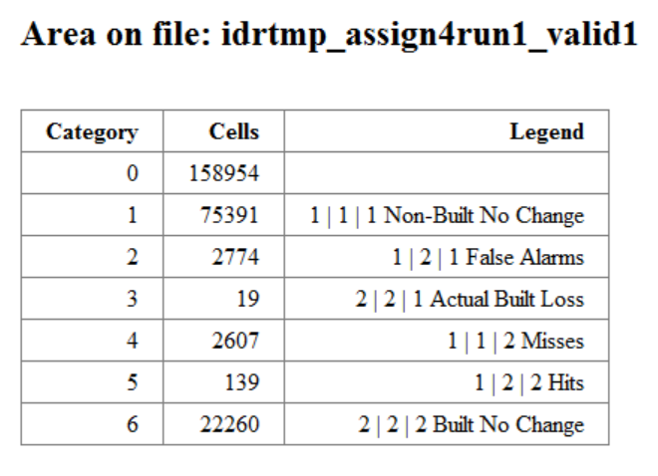
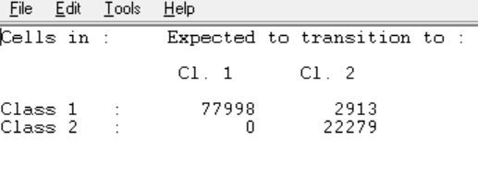
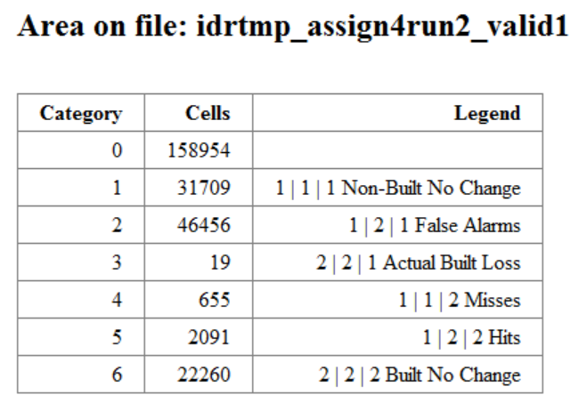
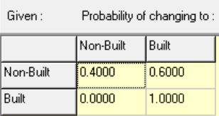
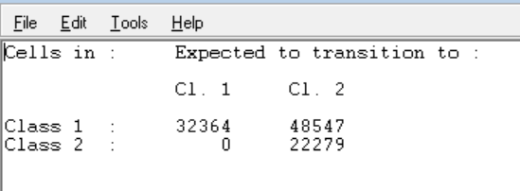
A paragraph that describes how the Markov matrix for each run relates to the
number of Misses, Hits, and False Alarms for each run. 5 points
Validation Run1
Markov Matrix Run 1 (above)
Run 1: The Markov Matrix tell the models that that 96.4% of the non-built pixels in the starting image are to remain non-built and 3.6% of the non-built pixels are subject to change to built while none of the built pixels in the start image will be unbuilt in the second time – for run 1 Markov expected
1999 transition potentials Run 1 (above)
that 2913 pixels will be changed from built to built as can be seen in fig 2 (text file output of Markov Matrix), which it did. The sum of Hits (139) and false alarms (2774), aka the predicted change is equal to 2913 (the same can be said for run 2 but with different numbers of pixels which instead add up to 48547). In run1 we told the Markov Matrix to predict no change from Built to non-built, however there were 19 pixels that were unbuilt in 1999 which accounts for category 3, Actual Built Loss. It is not a psychic model and won’t predict everything “perfectly” and it missed an additional 2607 pixels (category 4) that it predicted would remain non-built but were in fact built.
Run 2: The Markov Matrix Tells the model that that 40% of the non-built pixels (32364 pixels) in the starting image are to remain non-built and 60% (48547 pixels) of the non-built pixels are subject to change to built. None of the built pixels in the start image will but unbuilt in 1999
This is why there are so many more false alarms in run 2 than in run 1 because the Markov Matrix predicts much more change than in Run 1, however the actual
Validation Run2
Number of pixels in 1999 has not changed between Runs 1 and 2, so that is why Actual built loss is the same. Because Run 2 predicts so much more change than in run 1 there are a lot more hits and fewer misses in run 2 compared to run 1 – it is jut more likely to correctly identify Actual Change because it is changing substantially more pixels.
Markov Matrix Run 2 (above)
1999 transition potentials Run 2 (above)
Notes:
Submit exactly one that includes the following bullets. 35 points
The validation maps from CROSSTAB which compare three maps with mask01. 30 points
A paragraph that describes how the Markov matrix for each run relates to the
number of Misses, Hits, and False Alarms for each run. 5 points

Slide 5
These are the two Validation maps for each run of the LCM. The first map, Run1 is the more “conservative” estimate. We specified For run 2 there are the limitations are that the model over predicts the amount of built change(although it was instructed to do so) and therefore has a lot of False Alarms, however it does have more hits/fewer misses than Run1. Run1 is a bit more conservative in its predictions so there are a lot fewer false alarms but more misses. Although it is important to note that both runs missed the 19 pixels that were unbuilt, but that is because we told the model not to change any pixels from built to un-built.
The main limitations of these maps is that there is a lot of information missing compared to the cross-classification maps on the other slide. We cannot see the boundaries of the study area although they are a little more defined in Run2 than in Run1. The legend of the maps are also lacking. There are more categories on the previous slides which account for the Built-change and built-no change. In these two maps on this slide, we have two categories of misses, ones that account for actual misses and the other which account for Actual Built Loss (as written on the previous slide), however the fact that it is written as “Misses” on this slide is misleading. Its not a “miss” because we did not instruct the module to predict any pixels to become unbuilt.
Validation Run 1
Validation Run 2
Notes:
Submit exactly one slide that includes the following bullets. 25 points
A group of validation maps that the LCM generates for each run. 20 points
A paragraph that describes the limitations of the validation maps from the Land Change Modeler(LCM). 5 points

Slide 6
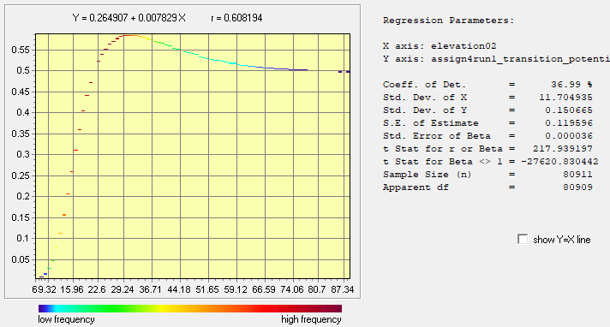
REGRESS Module
Mask
Elevation Bin
Potential for Transition Maps
The was used mask in the REGRESS module as it makes out the built pixels, leaving only the non-built pixels because these are the pixels that are candidates for being built in 1999 and the pixels, we are interested in. If we were to not mask out the already built pixels, we would not be able to distinguish between the pixels that are candidates for being built and those that are already built in the Potential for transition map, which is not useful for us in our analysis.
The REGRESS graph shows the elevation bins on the X-axis and the potential for transition from 1 to 2 on the y-axis, the peak of the regress line represents the elevation bin with the highest potential for transition identified by the MLP algorithm – which is at 29.24 meters with a Transition potential of .60. This is also a more frequent elevation value than the elevations of higher value. As elevation increases the Potential for Transition lowers slightly but still has a relatively high potential for transition compared to the values below 29.24 meters. Generally, it would appear the lowest elevations how the lowest Potential for transition but are much higher in frequency (darkest red), and that Potential for transition increases steeply until reaching 29.24, decreases at a steady rate and then plateauing at .50
Notes:
4. Submit exactly one slide that includes the following bullets. 20 points
A group of an elevation 02 map, the transition potential map, and an appropriate mask to use with the REGRESS plot. 5 points
A clipboard of output from REGRESS. 5 points
A paragraph that describes why you used the mask that you did. 5 points
A paragraph that interprets the relationship between bullet 4(a) and bullet 4(b). 5 points

Slide 7
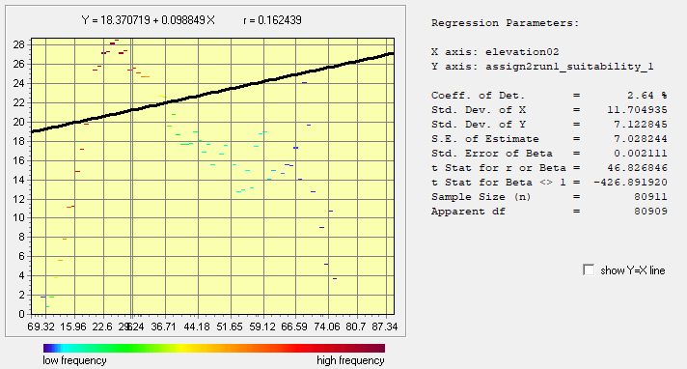
The most obvious difference is the mask. A4Potential for Transition Map has the pixels that were already built in 1985 masked out while the A2Run1 Suitability map does not have those pixels masked out, however after looking at GEOMOD parameters, I do not believe it is not possible to use a mask that removes the built pixels from the analysis because then GEOMOD would not be able to create an accurate Suitability map because it needs the built pixels to compare to the driver image in order to do so.
Something to note is that the two different maps have different scales/ranges. A2Run1 has a range from -1(the mask) to 29 while Transition Potential map ranges from 0 to .60. Which makes visual comparison a little difficult. I made a REGRESS plot for A2Run1 using the same mask as the REGRESS for A2 in the previous slide. The peak suitability value is a little lower than the peak transition potential for A4 but they are similar and within a few meters of each other (29 vs around 25). So, for both maps, midrange elevations are the most suitable while the lowest are the least. In the suitability map the higher elevation are less suitable than in the Potential for Transition maps, however there is a spike around 70 meters where the suitability values increase but then decrease again.
A2 Run1 Suitability Map
A4 Transition Potential
REGRESS Module A2
Notes:
Submit exactly one slide with a paragraph that compares the transition potential values from MLP to the suitability values from Assignment 2 run 1. 10 points

Slide 8
How would you train your biological lab technicians to develop the skill to distinguish between no disease and a rare disease that occurs in 2% of the human population?
Would you give them 2 examples of the rare disease and 98 examples of no disease with the reason that only 2% of human population has the rare disease?
Would you give them 50 examples of the rare disease and 50 examples of no disease?

Slide 9
MLP takes a sample of the map on the left to produce the map on the right
Built gain in green is smaller than Non-Built Persistence in red
MLP uses only the red and yellow where number of red = number of yellow

Slide 10
How should we interpret the numerical values of the transition potentials?
elevation02
Transition potential for Gain of Built

Slide 11
Distribution shows change during 1971-1985.
Geomod computes for each elevation bin a suitability value =
(union of blue and yellow)/(union of blue, yellow, and red)
MLP considers only the yellow and a sample of the red.
LCM ignores where people built before 1971.

Slide 12
LCM considers only the non-Built at 1971. LCM ignores the history before 1971.
MLP considers the yellow and a sample of the red.

Slide 13
LCM samples the signal of 1971-1985 change so that Gain of Built equals Persistence of Non-Built
MLP considers this information,
where the size of yellow equals the size of red.
Notice how much less information this distribution has compared to two slides previous.

Slide 14
This is same data as previous slide concerning Non-Built at 1985
MLP learns the pattern like a gambler would.
GAME RULES ARE:
You choose a bin from the elevation map, then the casino selects a pixel randomly from your bin. If the randomly selected pixel is Built Gain during 1971-1985, then you win.
What rule would you use to select your bin in order to maximize the probability that you win?

Slide 15
This is same data as previous slide concerning Non-Built at 1985
MLP learns the pattern like a gambler would.
GAME RULES ARE:
In each bin, probability of winning equal to (size of yellow) / (size of union of yellow and red)
Pontius selects bin at elevation 61.

Slide 16
MLP creates a smooth relationship of transition potential as a function of elevation
The smooth relationship requires splitting elevation into bins, computing Built Gain as a proportion of each bin, then smoothing across bins.
Pontius finds the documentation lacking concerning how to select the bins and the function that smooths.

Slide 17
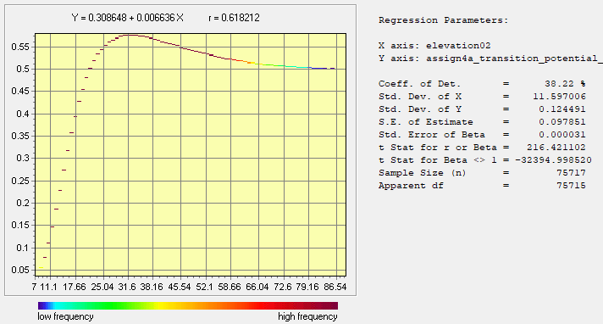
MLP creates this relationship based on random selection among pixels of Non-Built Persistence 1971-1985

Slide 18
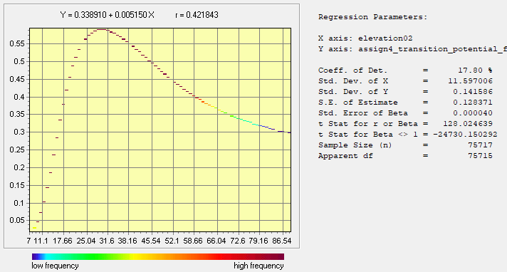
Why would MLP create a different relationship when running the software with the same inputs?

Slide 19
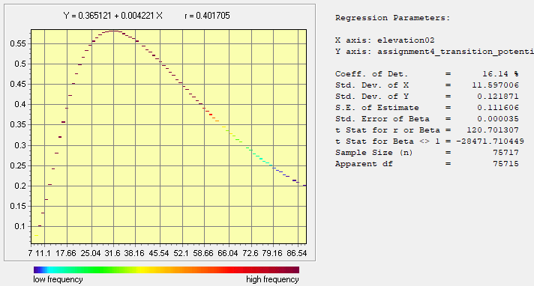
The relative rank is consistent across MLP runs and LCM uses only the ranks for allocation.

Slide 20
Modeling Vocabulary
Sensitivity Analysis is the procedure to measure how the variation in model parameter(s) influences the model output. Modelers use sensitivity analysis to determine the parameters that have relatively more influence on the output compared to the parameters that have relatively less influence on the output. Sensitivity analysis is helpful when the modeler does not know the value(s) to use for the model parameter(s).

Slide 21
Assignment 6
The purposes of assignment 6 are to learn the challenges of:
deciding among various fitting algorithms.
simulating more than one gaining category.

Slide 22
Maps of Forest, Other, Built

Slide 23
Maps of Forest, Other, Built

Slide 24
Maps of Forest, Other, Built

Slide 25
Crosstab of 1971, 1985, 1999. 1=Forest, 2=Other, 3=Built

Slide 26
Maps of Forest, Other, Built 1971-1985
There are three transitions of change.

Slide 27
Maps of Forest, Other, Built 1985-1999
There are five transitions of change.
Other to Forest
&
Built to Other
did not exist during 1971-1985.

Slide 28
Assignment 6’s one independent variable

Slide 29
Assignment 6
Perform two runs with LCM. Earlier time image is 1971ForestOtherBuilt. Later time image is 1985ForestOtherBuilt. Group all transitions into one sub-model. Independent variable is distance to 1971 Built, which was used in Assignment 5. First run uses SVM and second run uses Decision Forest to compute transition potential maps. Use Regress to plot transition potential versus distance to 1971 built. Allocate change using the Markov matrix with the proportions during 1971-1985 to predict 1999. For each run, use three-way crosstab to compare 1985ForestOtherBuilt1, the 1999 prediction, and 1999ForestOtherBuilt1 using Mask01. Enhance the legend of the three-way crosstab to denote each output category as Miss, False Alarm, Hit, Correct Rejection, Wrong Hit, Wrong Hit & Unpredicted, Miss & Unpredicted, or Built Persistence. Unpredicted is a transition that exists in the reference change during 1985-1999 but that LCM did not try to predict, perhaps because the transition did not exist during 1971-1985.
Submit exactly six slides. Slide 1 is title slide. Slides 2-4 show SVM results on left and Decision Forest results on right, where each slide shows two REGRESS plots and two transition potential maps.
Slide 2 shows the REGRESS scatter plots and maps for transition potential from 1 Forest to 2 Other.
Slide 3 shows the REGRESS scatter plots and maps for transition potential from 1 Forest to 3 Built.
Slide 4 shows the REGRESS scatter plots and maps for transition potential from 2 Other to 3 Built.
Slide 5 shows validation maps from CROSSTAB with SVM on the left and Decision Forest on the right. For each algorithm, report the numbers of pixels of Hits, simulated change, and reference change during 1985-1999. Report also the number of pixels of reference change during 1971-1985. Explain why the following three sizes differ: reference change during 1971-1985, simulated change during 1985-1999, and reference change during 1985-1999.
Slide 6 gives your written response to the following: If colleagues ask you whether they should use SVM or Decision Forest or something else to predict land change, then how would you respond? Describe the role that verification, overfitting, and validation plays in your response. Your response must give guidance to your colleagues to refine their thoughts.

Slide 30
Rubric for assignment 6
Submit exactly one slide with your name(s). 5 points
Submit exactly one slide which shows REGRESS scatter plots and transition potential maps with enhanced legend from 1 Forest to 2 Other. 15 points
Submit exactly one slide which shows REGRESS scatter plots and transition potential with an enhanced legend from 1 Forest to 3 Built. 15 point
Submit exactly one slide which shows REGRESS scatter plots and transition potential maps with an enhanced legend from 2 Other to 3 Built. 15 point
Submit exactly one slide which includes following bullets: 30 point
Validation maps from CROSSTAB with SVM on the left and Decision Forest on the right. 10 points
Report the numbers of pixels of Hits, simulated change, and reference change during 1985-1999. 9 points
Report also the number of pixels of reference change during 1971-1985. 5 points
Explain why the following three sizes differ: reference change during 1971-1985, simulated change during 1985-1999, and reference change during 1985-1999. 6 points
Submit exactly one which includes following bullets: 15 points
If colleagues ask you whether they should use SVM or Decision Forest or something else to predict land change, then how would you respond? 5 points
Describes the role that verification, overfitting, and validation plays in your response. 10 points
Bonus. 5 points

Slide 31
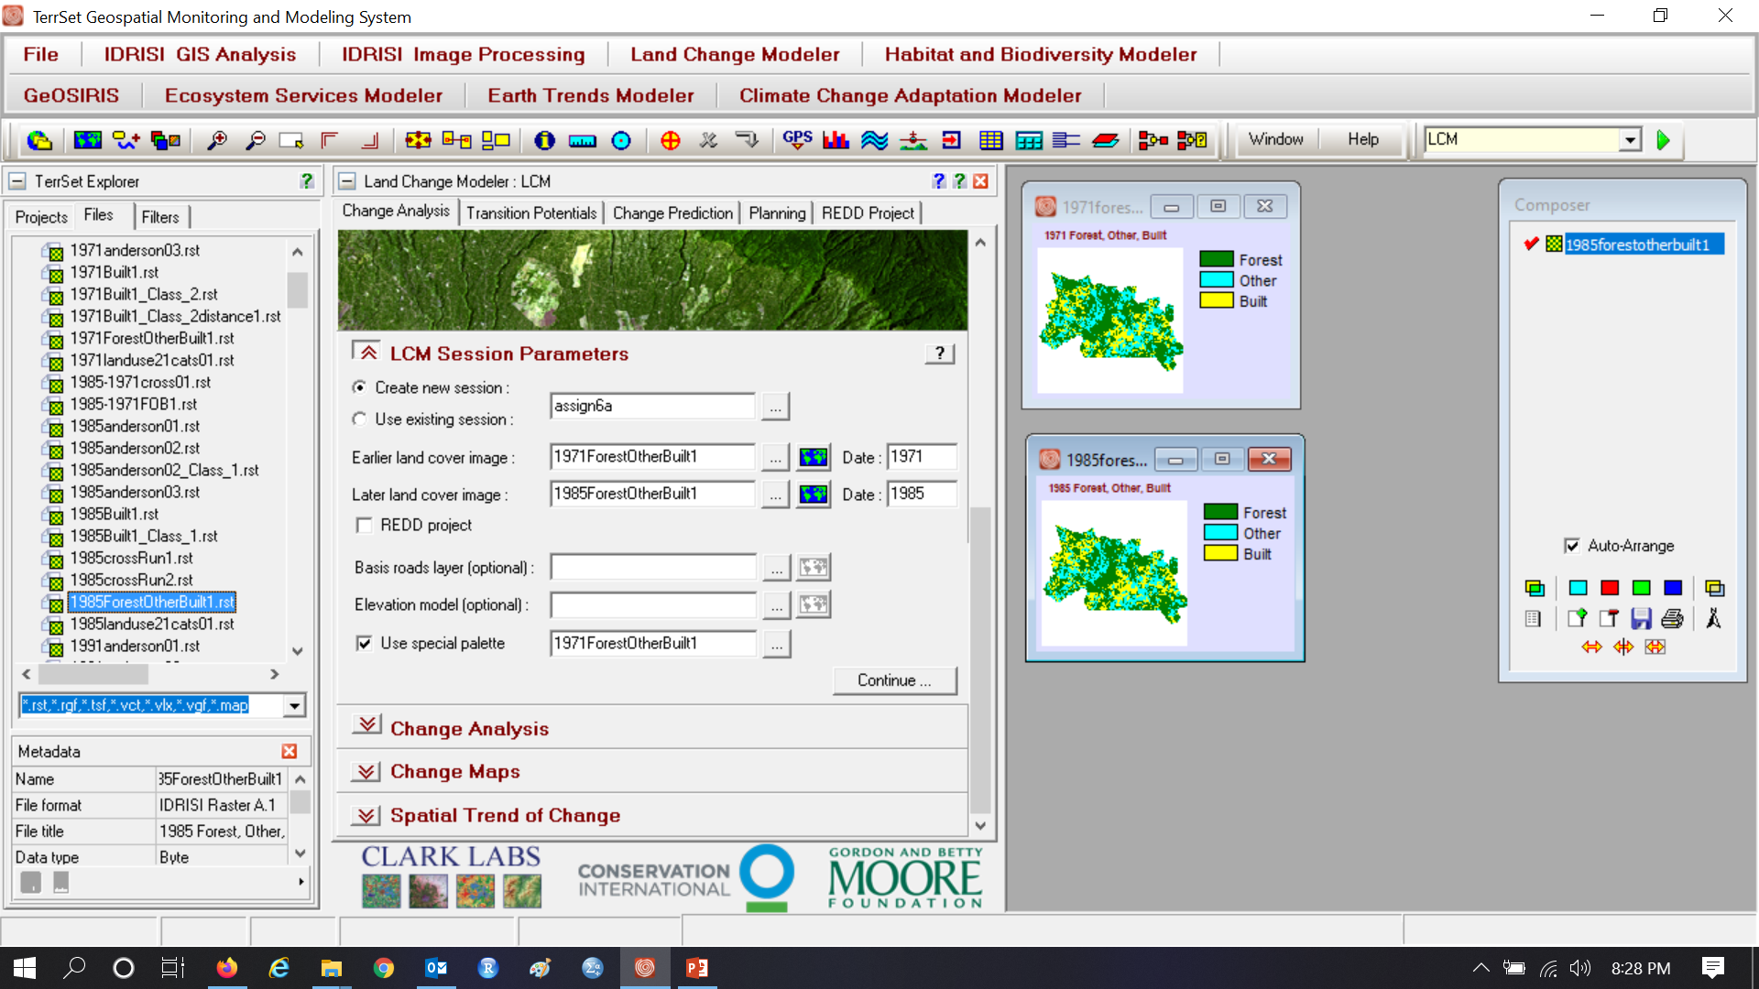
Assignment 6

Slide 32
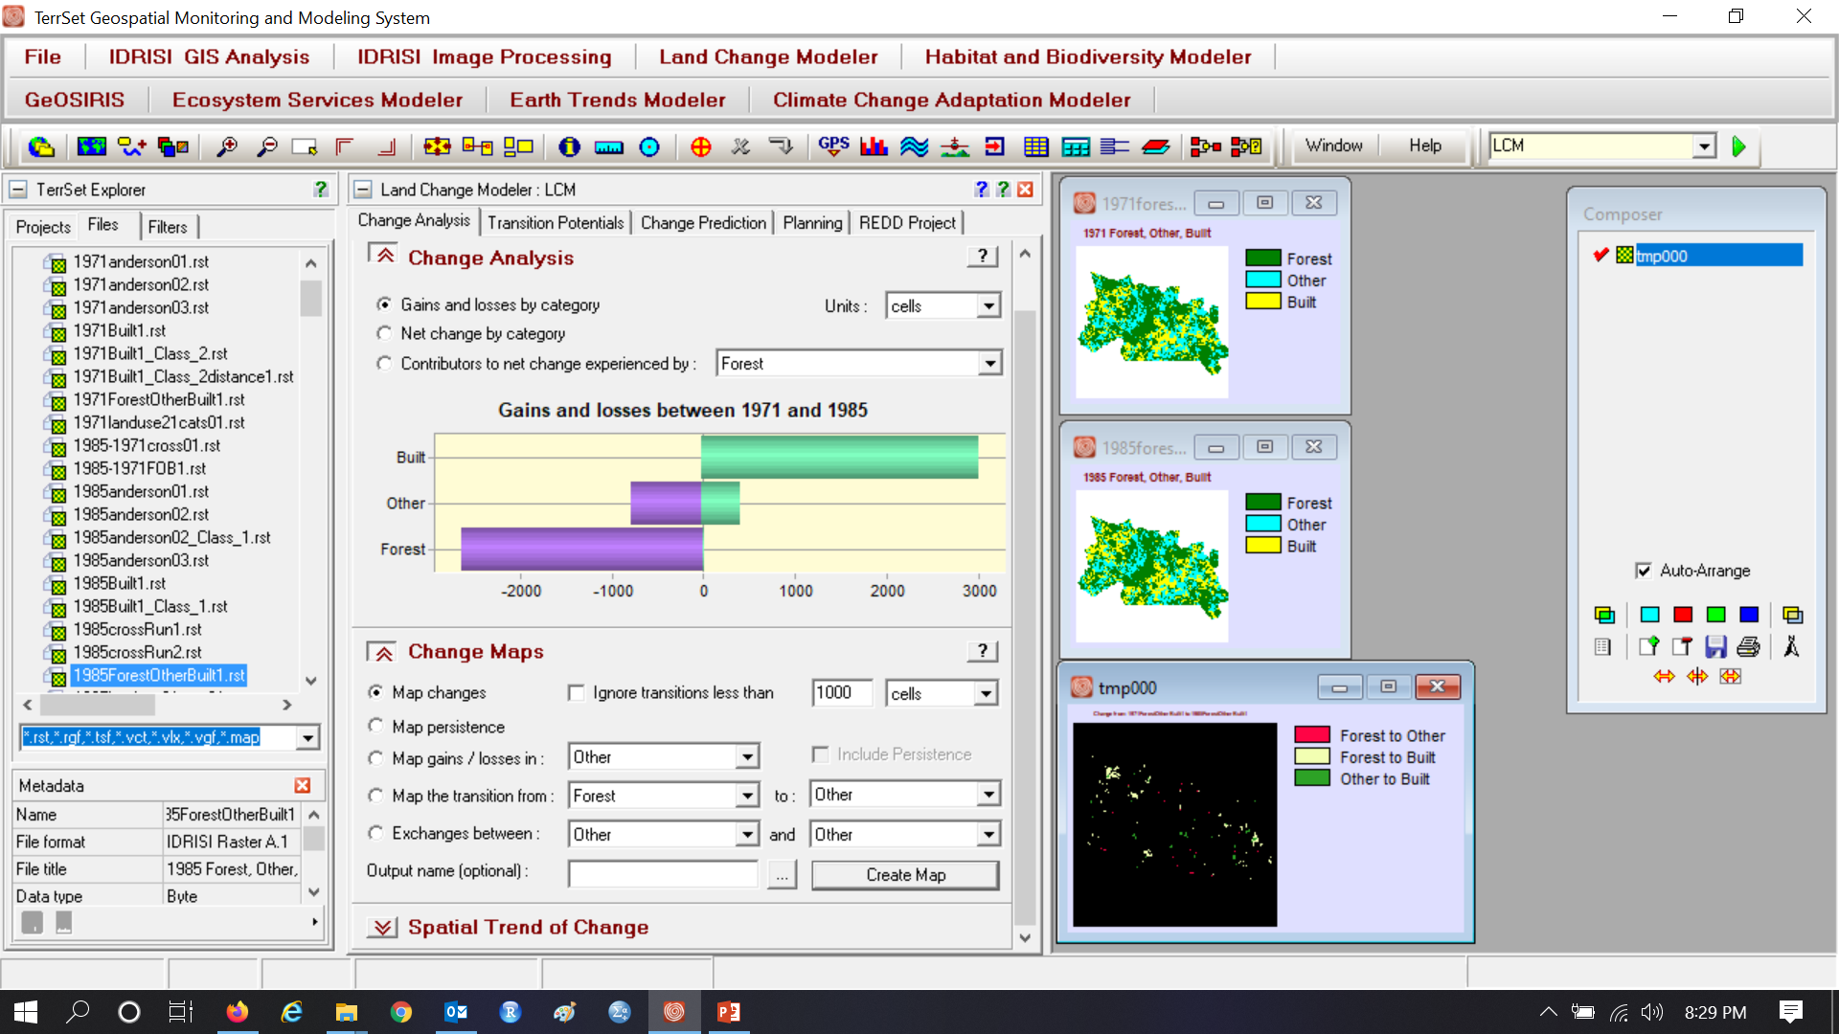
Notice exact three transitions are positive

Slide 33
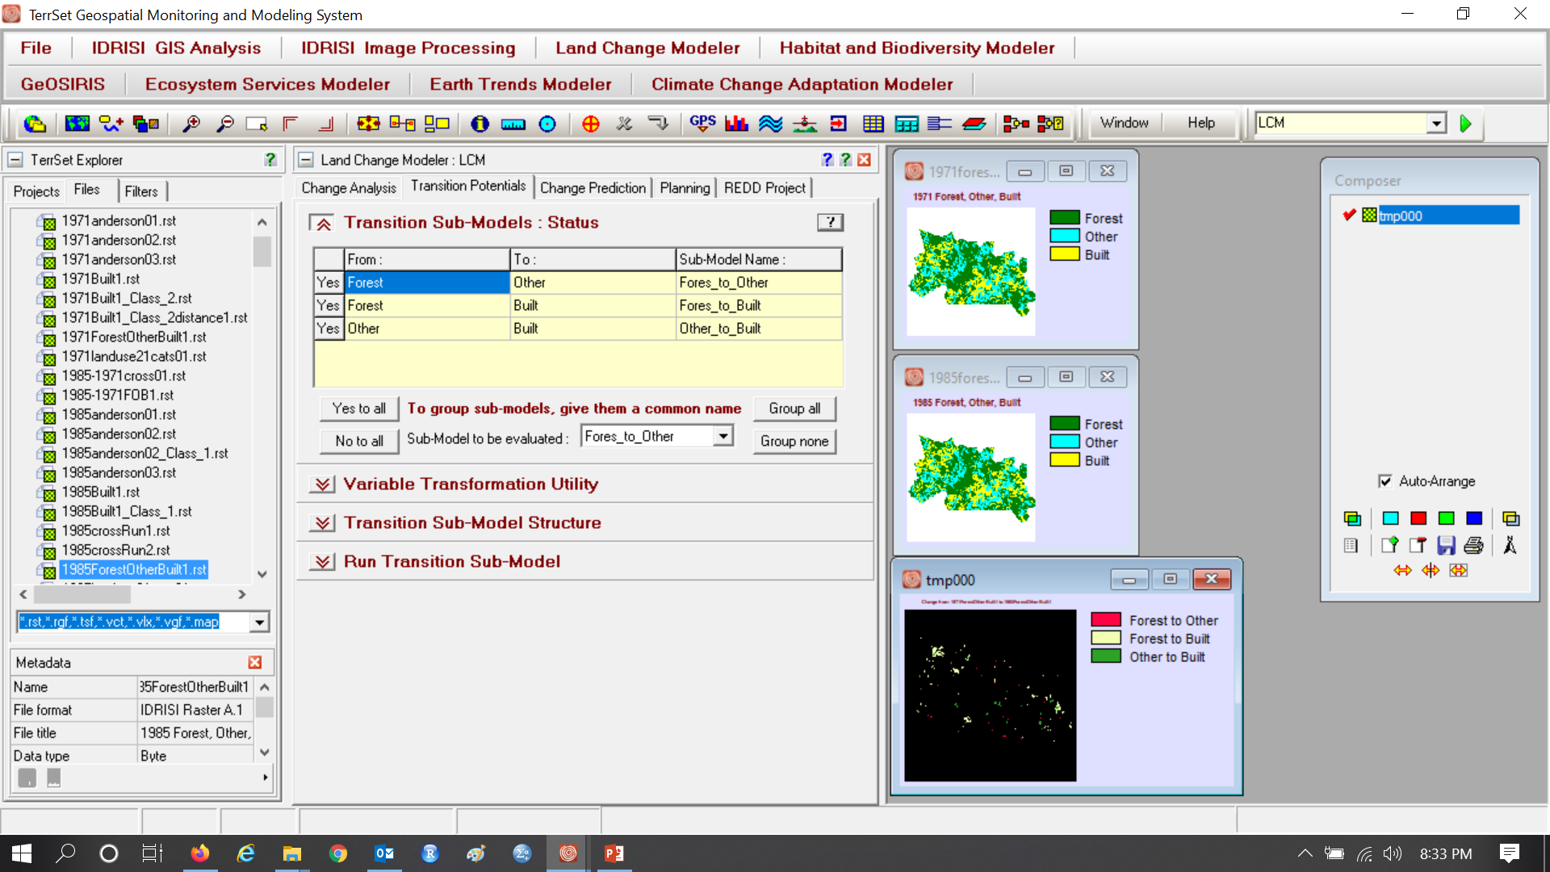
Click Group all, so distance determines all transitions.

Slide 34
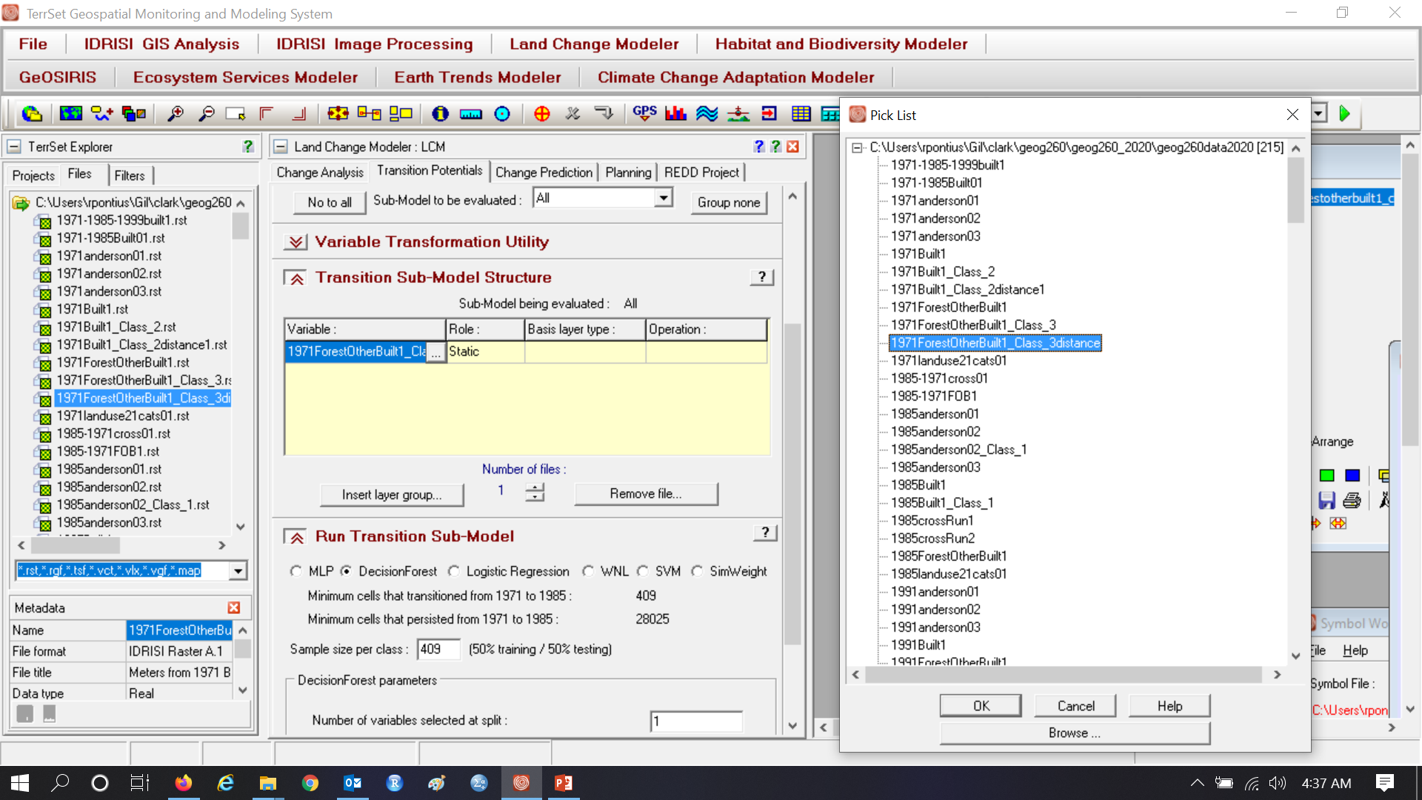
Assignment 6

Slide 35
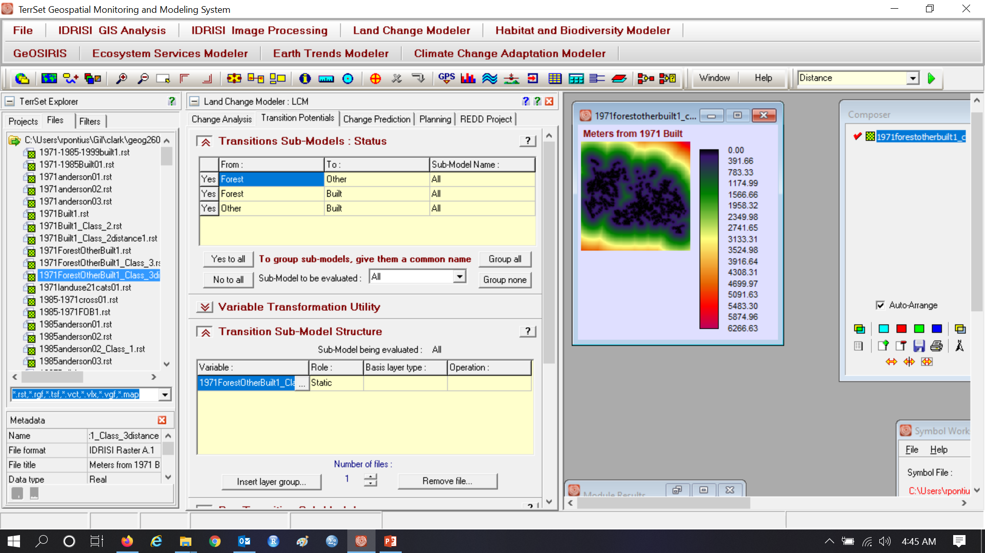
Assignment 6

Slide 36
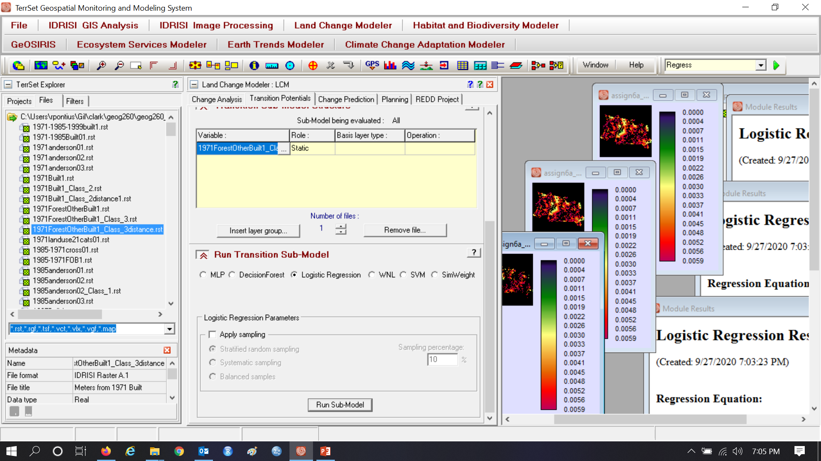
This illustrates Logistic Regression without sampling. Assignment 6 uses SVM and Decision Forest.

Slide 37
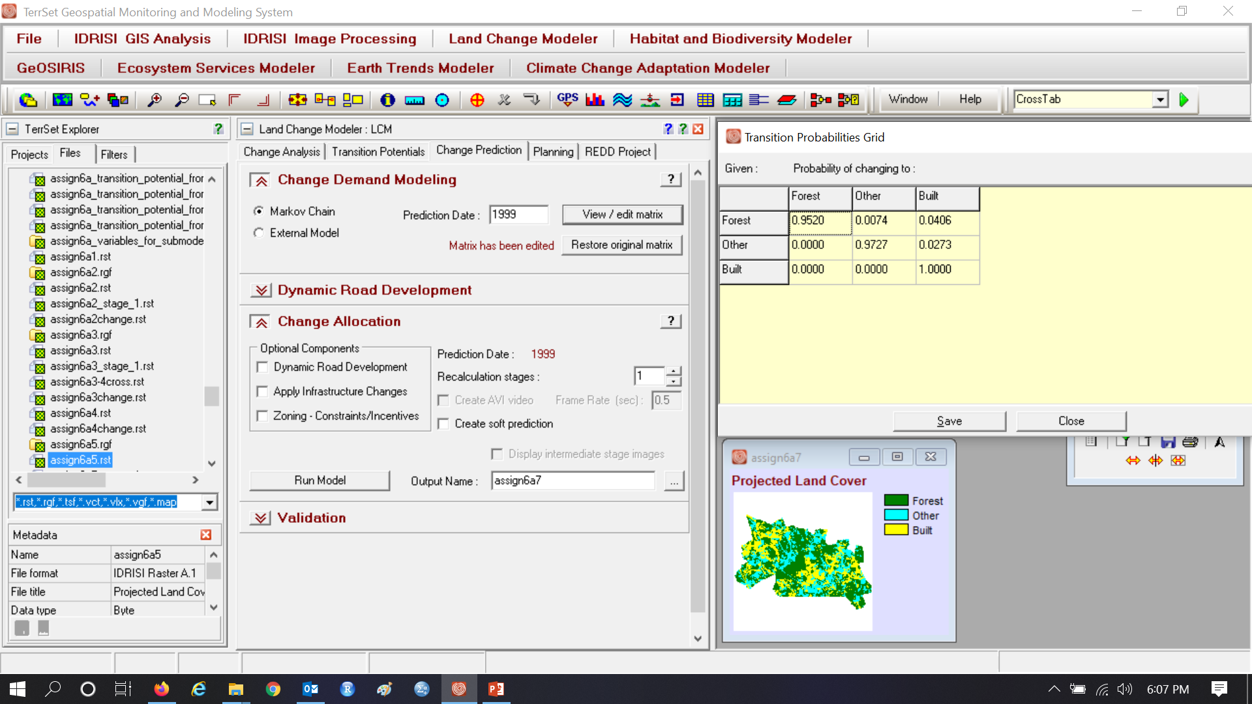
Prediction Date is 1999, which makes the duration of calibration interval the same as the prediction interval

Slide 38
Markov Matrix gives the proportion, not probability, of the earlier category in each row that transitions to a later category in the column. Other and Built compete to gain from Forest.

Slide 39
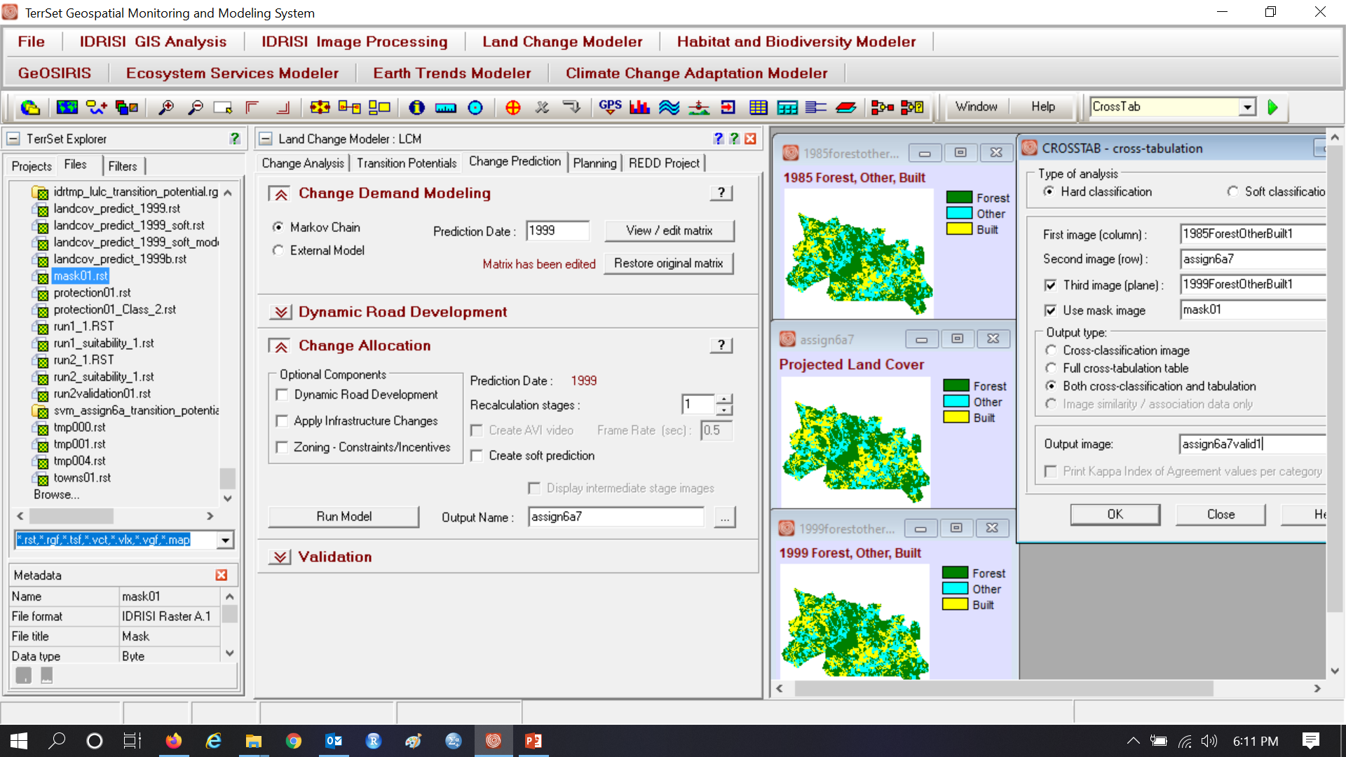
Use CROSSTAB to create validation map

Slide 40
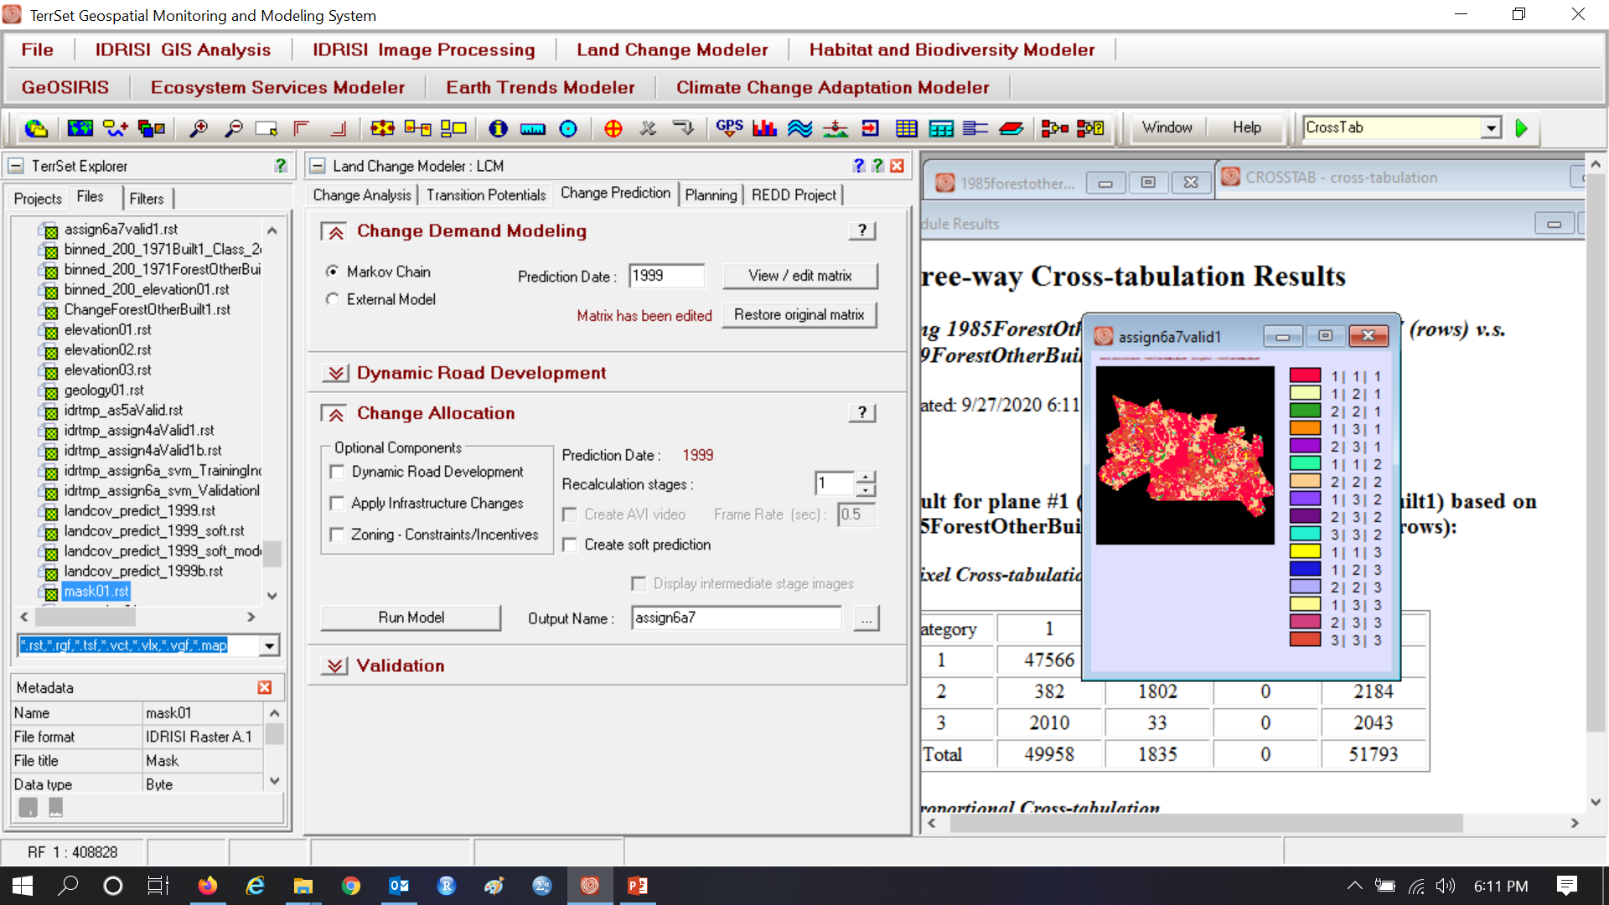
Interpret each combination

Slide 41
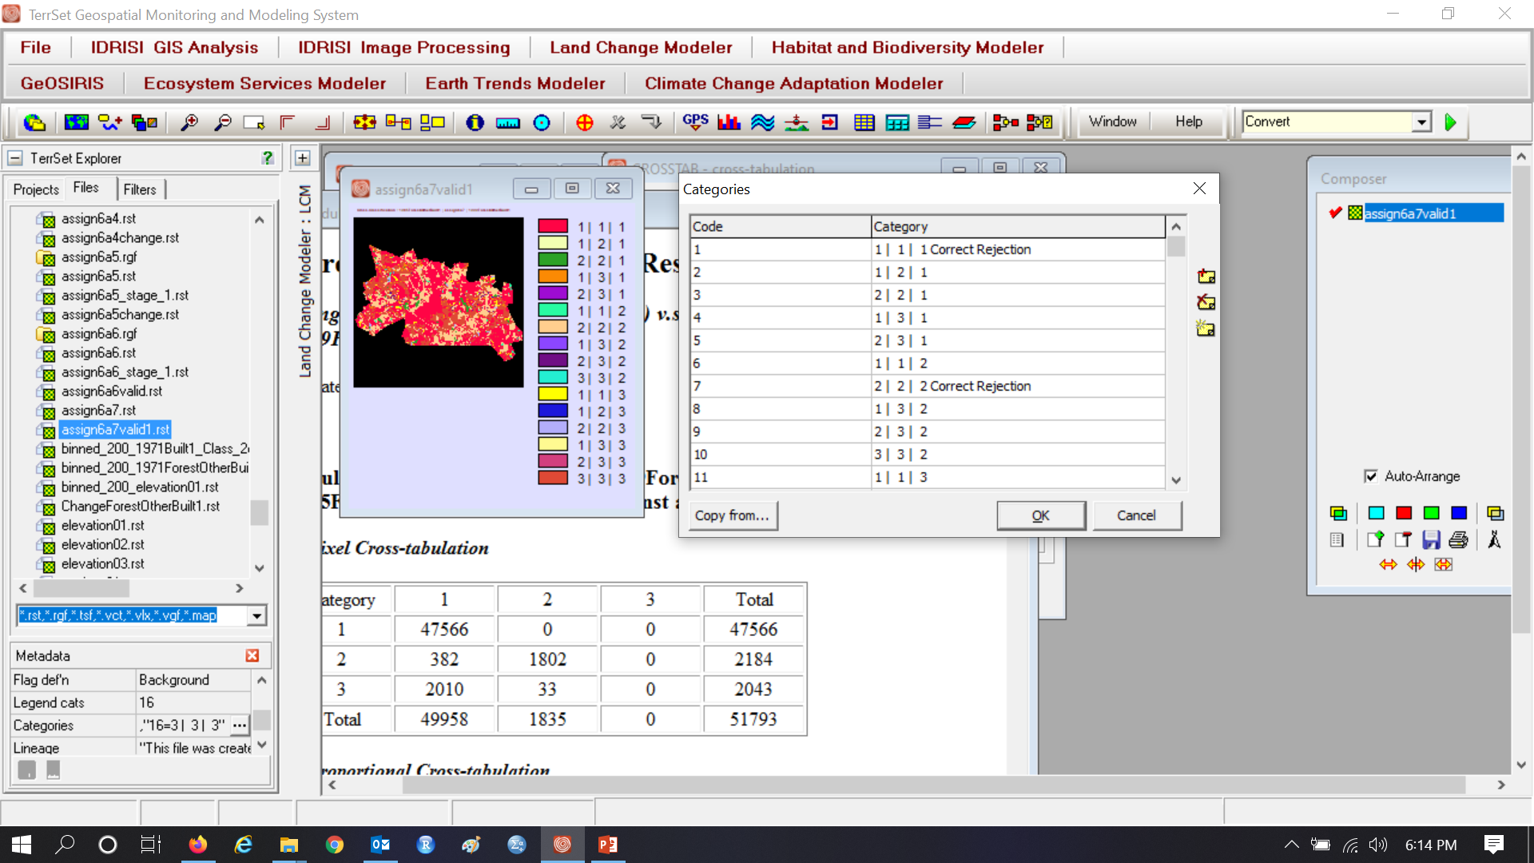
1 | 1 | 1 is a Correct Rejection of Forest 2 | 2 | 2 is a Correct Rejection of what?

Slide 42
This map is validation of simulation that uses Logistic Regression. Wrong Hit is reference change simulated as change to the wrong gaining category. Unpredicted is a transition that exists in the reference change during 1985-1999 but that LCM did not try to predict, perhaps because the transition did not exist during 1971-1985.

Slide 43
Forest to Other transition potential
Start of extrapolation
Positive values are Forest at 1985.
Non-Forest at 1985 is zero.

Slide 44
Forest to Built transition potential
Start of extrapolation
Positive values are Forest at 1985.
Non-Forest at 1985 is zero.

Slide 45
Other to Built transition potential
Start of extrapolation
Positive values are Other at 1985.
Non-Other at 1985 is zero.

Slide 46
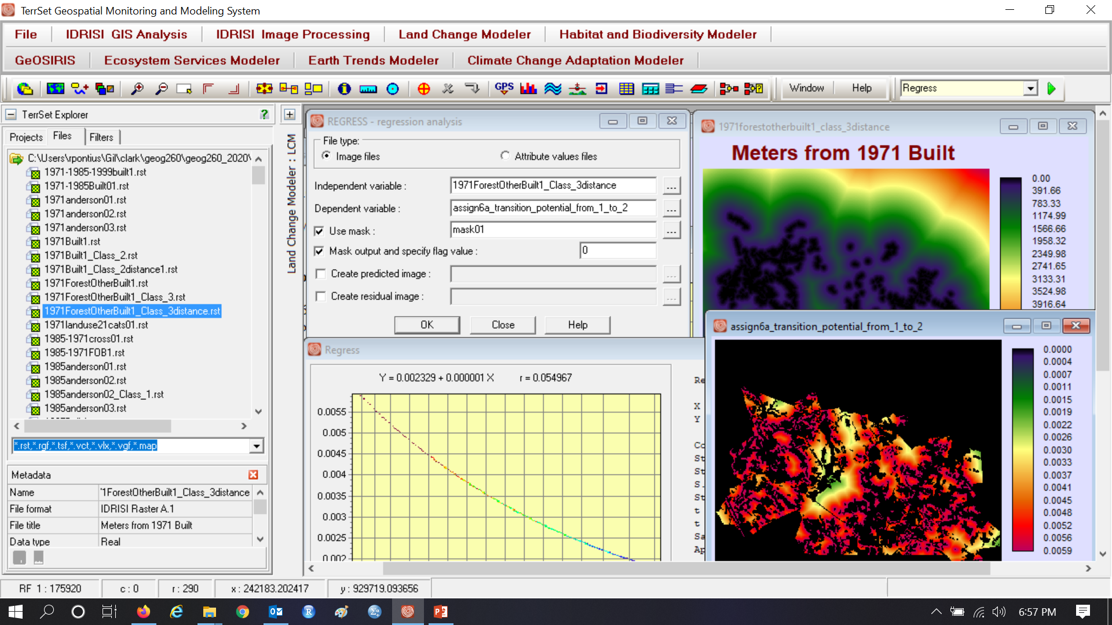
Logistic Regression transition potential from Forest to Other

Slide 47
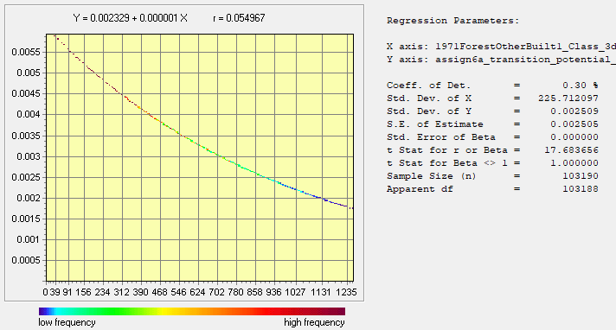
Logistic Regression transition potential from Forest to Other
Transition Potential versus distance
Positive values are Forest at 1985.
Non-Forest at 1985 is zero.

Slide 48
Logistic Regression transition potential from Forest to Built
Transition Potential versus distance
Positive values are Forest at 1985.
Non-Forest at 1985 is zero.

Slide 49

Other to Built transition potentials are zero for 1985 Other. Forest to Built transitional potentials are zero for 1985 Forest.
Transition Potential versus distance
Positive values are Other at 1985.
Non-Other at 1985 is zero.

Slide 50
Definitions of Overfit and Underfit
A mathematical relationship is overfit to the calibration data when the mathematical relationship is specific to the calibration data to a level of detail that is not important for the purpose, which frequently is to extrapolate.
A mathematical relationship is underfit to the calibration data when the mathematical relationship fails to express patterns in the calibration data that are important for the purpose, which frequently is to extrapolate.

Slide 51

Research Gate sent this to Pontius

Slide 52
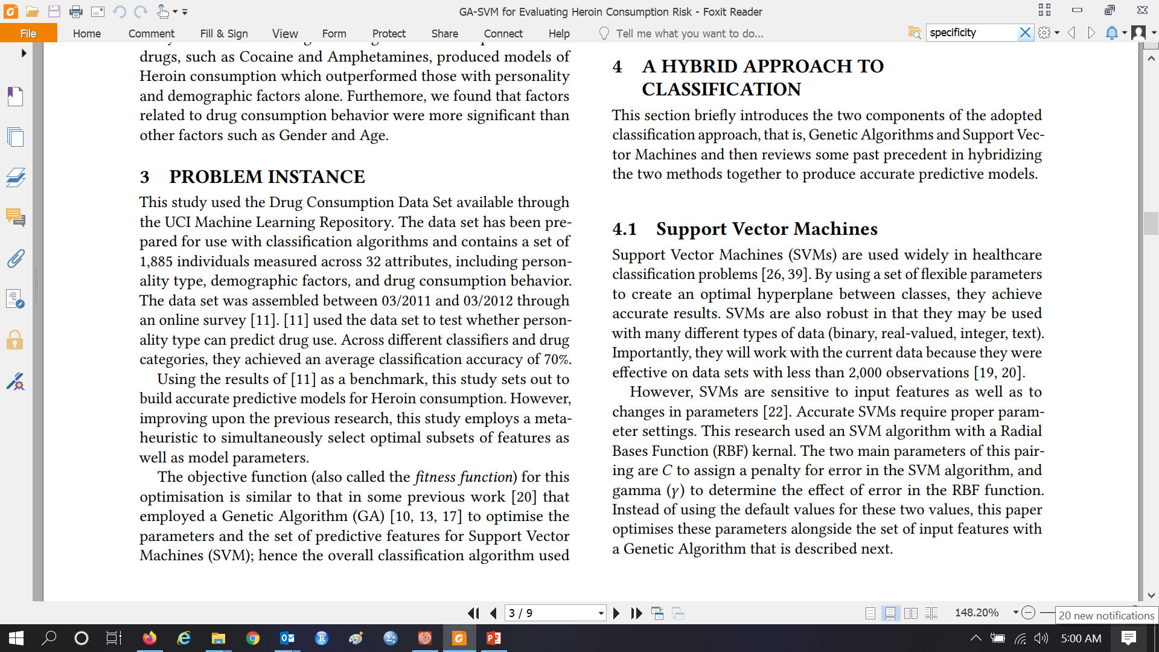
Authors use SVM for research on drug addiction

Slide 53


Flow Matrix offers an alternative to Markov Matrix
The literature on Moodle gives
Measuring the temporal instability of land change using the Flow matrix
Jess Strzempko compared the behavior of the Flow and Markov matrices in her Masters research, then won an award at the AAG meeting. Strzempko is now working with Professor Pontius to publish this research while she has a cool GIS job that involves traveling to Ghana.

